Slide 1
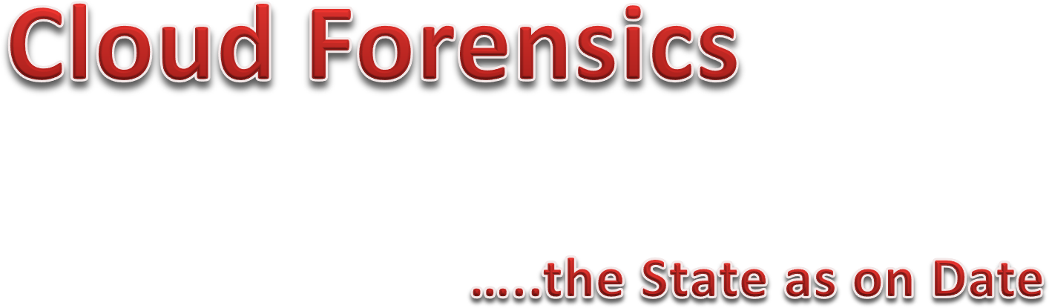
By : NGOSA GATHAMS

Slide 2




Background knowledge of Cloud Computing, Digital Forensics & Cloud Forensics.
Challenges in Cloud Forensics
Existing Proposed Solutions.
Advantages of cloud forensics over traditional Computer Forensics
Provide an evaluation of existing digital forensics tools in a Cloud Environment
Amazon Simple Storage Service
Khatamm!!!!

Slide 3
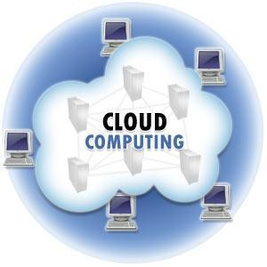




Background knowledge of Cloud Computing, Digital Forensics & Cloud Forensics.

Slide 4
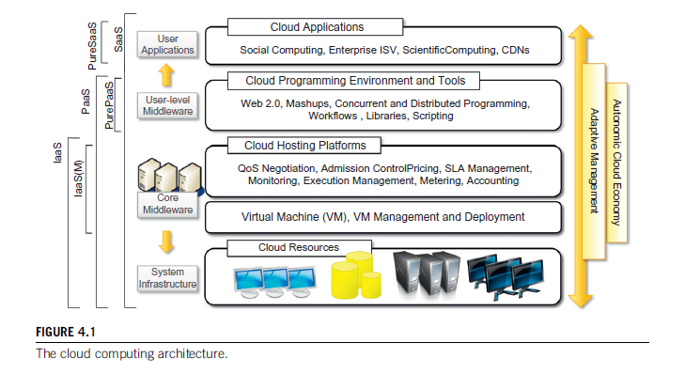
2. CLOUD REFERENCE MODEL

Slide 5

Cloud computing

Slide 6
DEFINITION
Cloud computing is a technology that uses the internet and central remote servers to maintain data and applications.
Cloud computing allows consumers and businesses to use applications without installation and access their personal files at any computer with internet access.

Slide 7
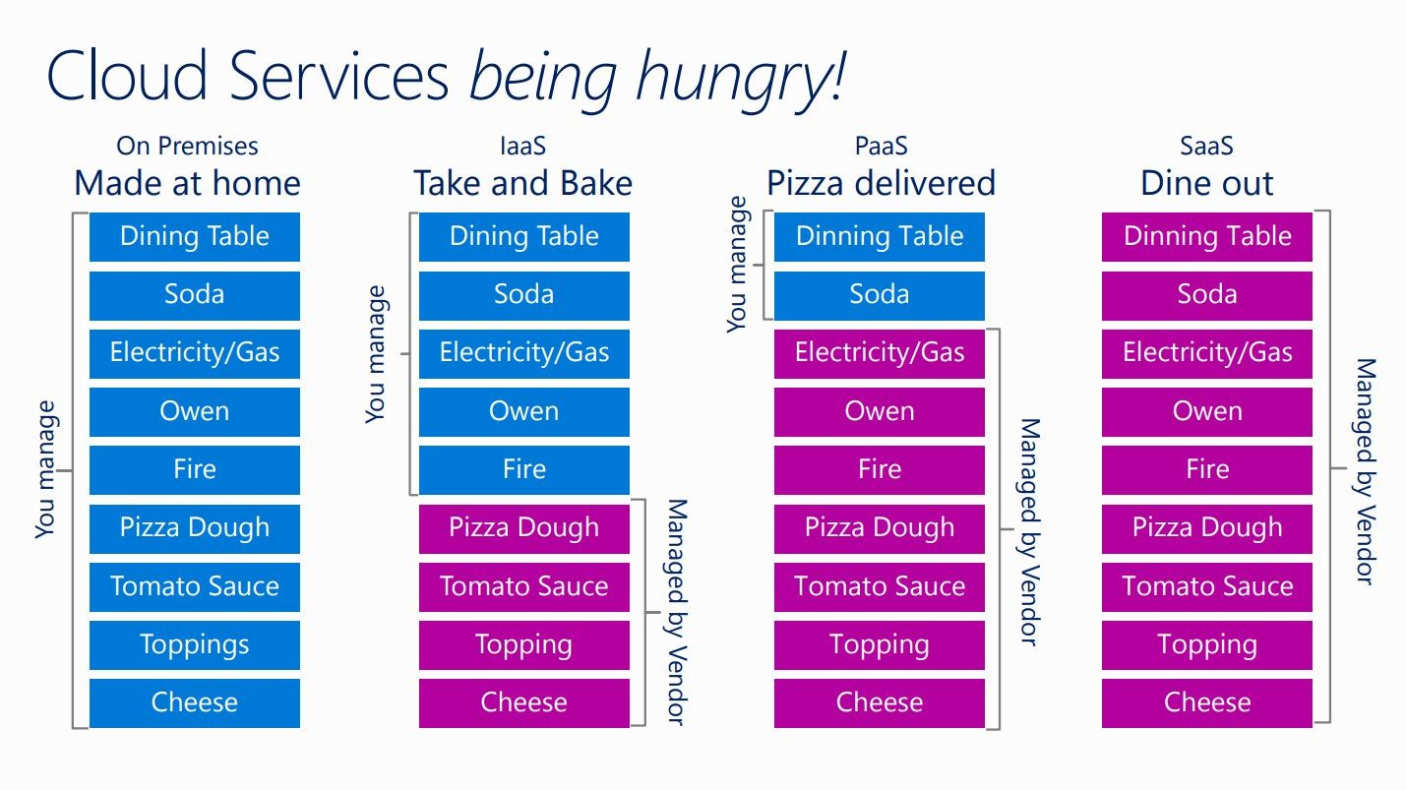

Slide 8
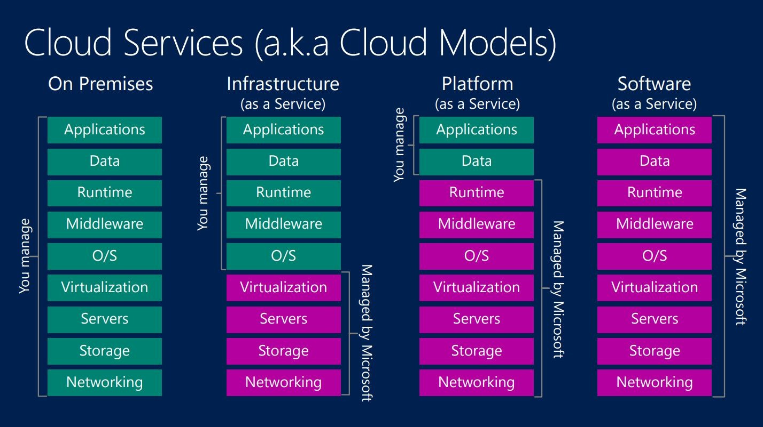

Slide 9
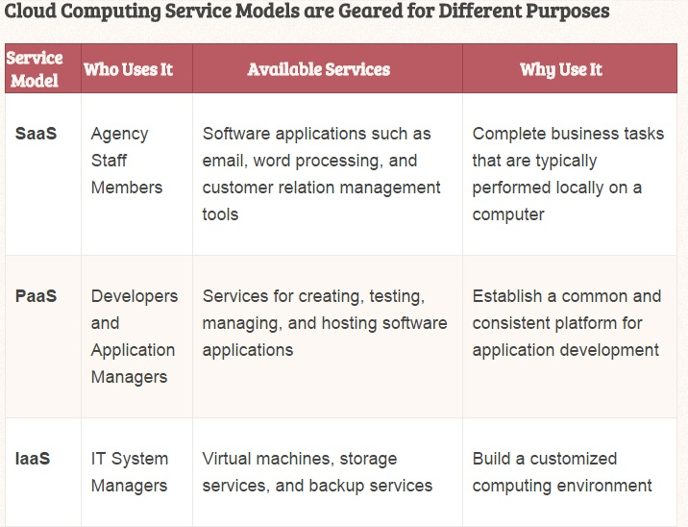
Service Models

Slide 10
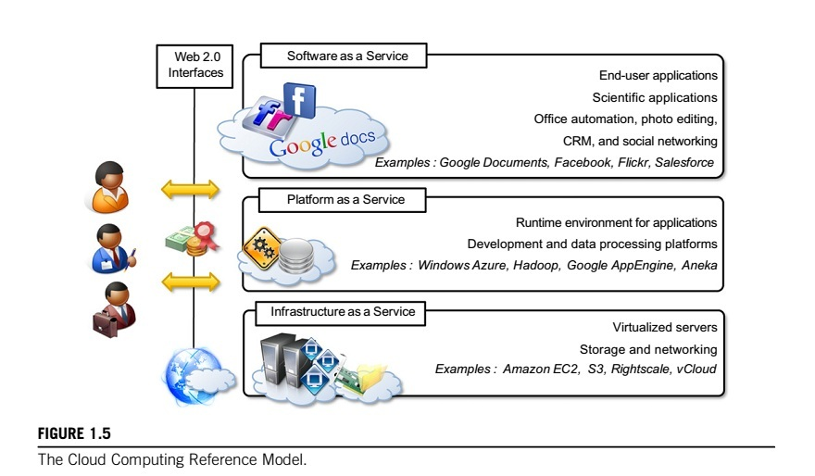
The cloud computing reference model

Slide 11
TYPES OF CLOUDS
Public clouds
Private clouds.
Hybrid or heterogeneous clouds.
Community clouds.

Slide 12
Public clouds. The cloud is open to the wider public.
Private clouds. The cloud is implemented within the private premises of an institution and generally made accessible to the members of the institution or a subset of them.
Hybrid or heterogeneous clouds. The cloud is a combination of the two previous solutions and most likely identifies a private cloud that has been augmented with resources or services hosted in a public cloud.
Community clouds. The cloud is characterized by a multi-administrative domain involving different deployment models (public, private, and hybrid), and it is specifically designed to address the needs of a specific industry.

Slide 13
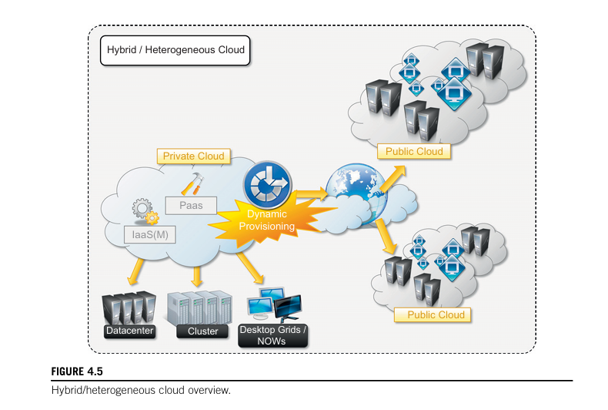
Hybrid clouds

Slide 14
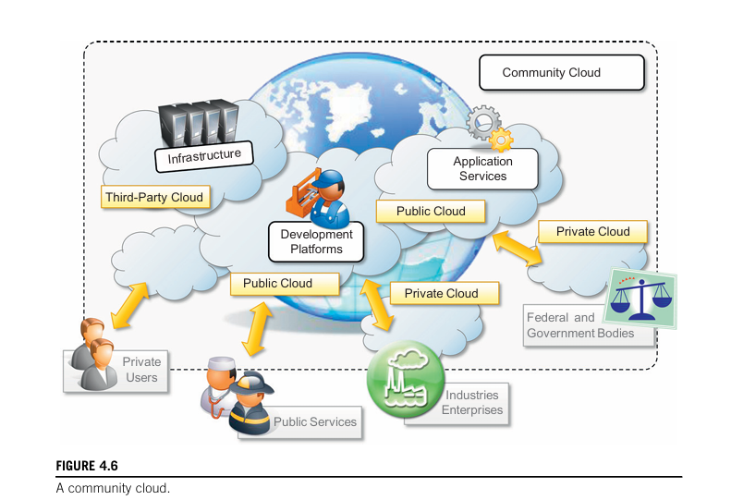
Community clouds

Slide 15
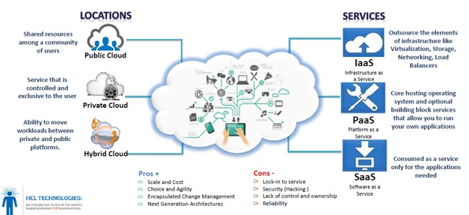
Locations & Services

Slide 16
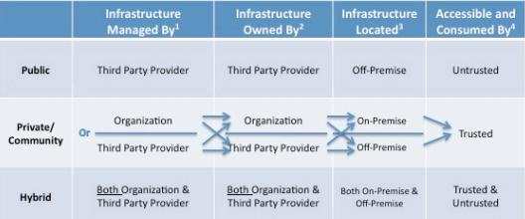
Deployment Models or cloud types
1. Public Cloud 3. Private Cloud
2. Community Cloud 4. Hybrid Cloud

Slide 17
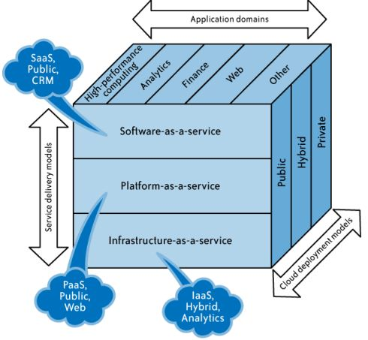
Cloud Computing Framework

Slide 18
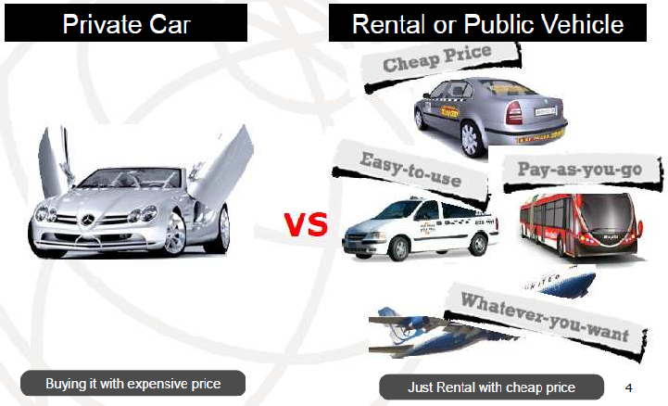
ESSENTIAL CHARACTERISTICS OF CLOUD

Slide 19
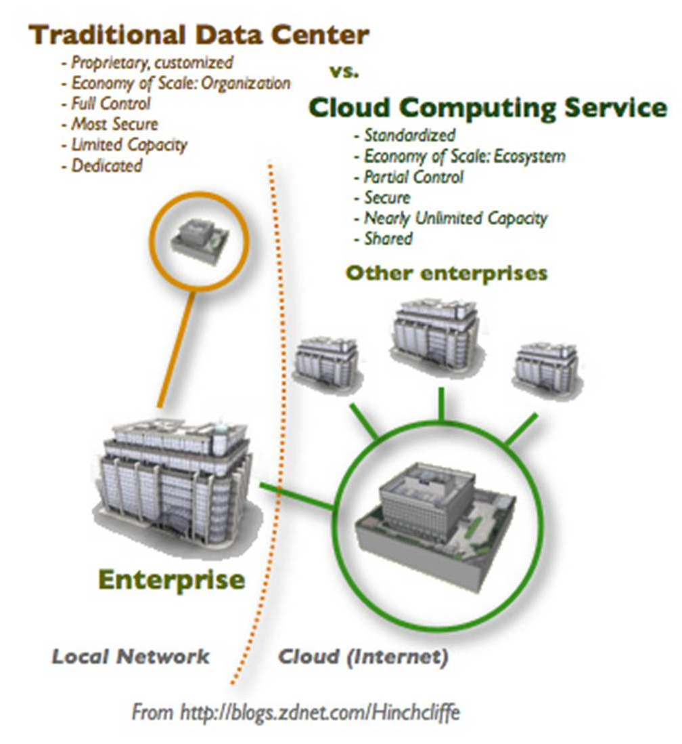
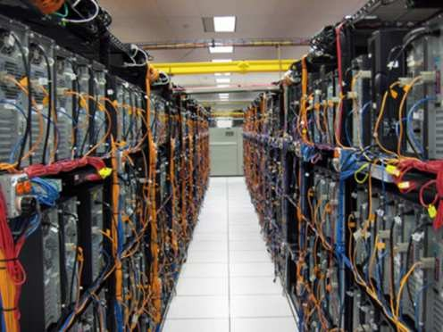
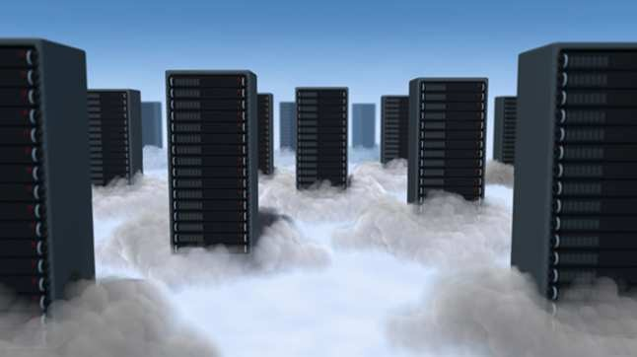
UNDERSTANDING THE DIFERENCES

Slide 20
Cloud Computing Framework
Hybrid Clouds
Deployment
Models
Private Cloud
Community
Cloud
Public Cloud
Service
Models
Software as a Service (SaaS)
Platform as a Service (PaaS)
Infrastructure as a Service (IaaS)
On Demand Self-Service
Essential
Characteristics
Broad Network Access
Rapid Elasticity
Resource Pooling
Measured Service
Massive Scale
Resilient Computing
Common
Characteristics
Homogeneity
Geographic Distribution
Virtualization
Service Orientation
Low Cost Software
Advanced Security

Slide 21
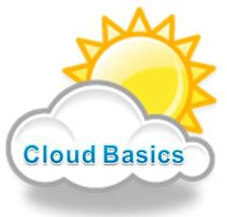





SaaS
PaaS
IaaS
Service Models
Private
Public
Community
Hybrid
Deployment Models
On-demand self service
Broad network access
Resource pooling
Rapid elasticity
Measured service
Essential Services

Slide 22

The DF as Defined by NIST
Definition of Digital Forensics
“The use of scientifically derived and proven methods toward the preservation, collection, validation, identification, analysis, interprétation, documentation, and preservation of digital evidence derived from digital sources for the purpose of facilitating or furthering the reconstruction of events found to be criminal, or helping to anticipate unauthorized actions shown to be disruptive to planned operations.”
--- DFRWS 2001

Slide 23

CLOUD FORENSICS as Defined by NIST
Definition of Cloud Forensics
Cloud forensics is the application of digital forensics science in cloud computing environments. Technically, it consists of a hybrid forensic approach (e.g., remote, virtual, network, live, large-scale, thin-client, thick-client) towards the generation of digital evidence. Organizationally, it involves interactions among cloud actors (i.e.,cloud provider, cloud consumer, cloud broker, cloud carrier, cloud auditor) for the purpose of facilitating both internal and external investigations. Legally it often implies multi-jurisdictional and multi- tenant situations.

Slide 24
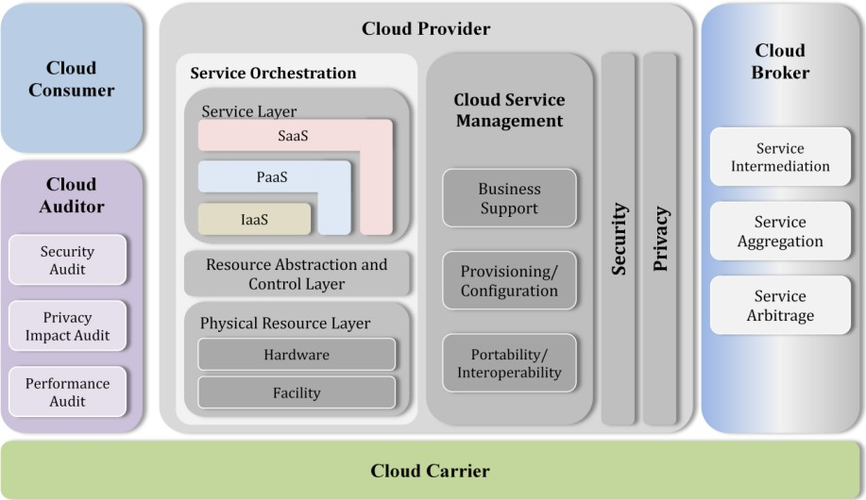
Cloud Conceptual Reference Model
Cloud High-level architecture
Five major actors with their roles, responsibilities, activities and functions in cloud computing.
Understanding of the requirements, uses, characteristics and standards of cloud computing.
Cloud Consumer
Cloud Provider
Cloud Broker
Cloud Auditor
Cloud Carrier
NIST Cloud Computing Reference Architecture

Slide 25
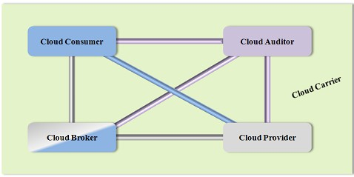
Actors in Cloud Computing
Cloud Consumer A person or organization that maintains a business relationship with, and uses service from, Cloud Providers.
Cloud Provider A person, organization, or entity responsible for making a service
available to interested parties.
Cloud Auditor A party that can conduct independent assessment of cloud services, information system operations, performance and security of the cloud implementation.
Cloud Broker An entity that manages the use, performance and delivery of cloud
services, and negotiates relationships between Cloud Providers and Cloud Consumers.
Cloud Carrier An intermediary that provides connectivity and transport of cloud services from Cloud Providers to Cloud Consumers.
NIST Cloud Computing Reference Architecture

Slide 26

Scenarios in Cloud: 1
Cloud consumer interacts with the cloud broker instead of contacting a cloud provider directly.
The cloud broker may create a new service (mash up) by combining multiple services or by enhancing an existing service.
Actual cloud providers are invisible to the cloud consumer.
NIST Cloud Computing Reference Architecture

Slide 27

Scenarios in Cloud: 2
Cloud carriers provide the connectivity and transport of cloud services from cloud providers to cloud consumers.
Cloud provider participates in and arranges for two unique service level agreements (SLAs), one with a cloud carrier (e.g. SLA2) and one with a cloud consumer (e.g. SLA1).
A cloud provider may request cloud carrier to provide dedicated and encrypted connections to ensure the cloud services (SLA’s).
NIST Cloud Computing Reference Architecture

Slide 28
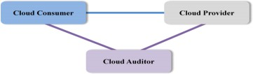
Scenarios in Cloud: 3
Cloud auditor conducts independent assessments for the operation and security of the cloud service.
The audit may involve interactions with both the Cloud Consumer and the Cloud Provider.
NIST Cloud Computing Reference Architecture

Slide 29
Cloud Consumer
Cloud consumer browses & uses the service.
Cloud consumer sets up contracts with the cloud provider.
Cloud consumers need SLAs to specify the technical performance requirements fulfilled by a cloud provider.
SLAs cover the quality of service, security, remedies for performance failures.
A cloud provider list some SLAs that limit and obligate the cloud consumers by must acceptance.
Cloud consumer can freely choose a cloud provider with better pricing with favorable conditions.
Pricing policy and SLAs are non-negotiable.
NIST Cloud Computing Reference Architecture

Slide 30
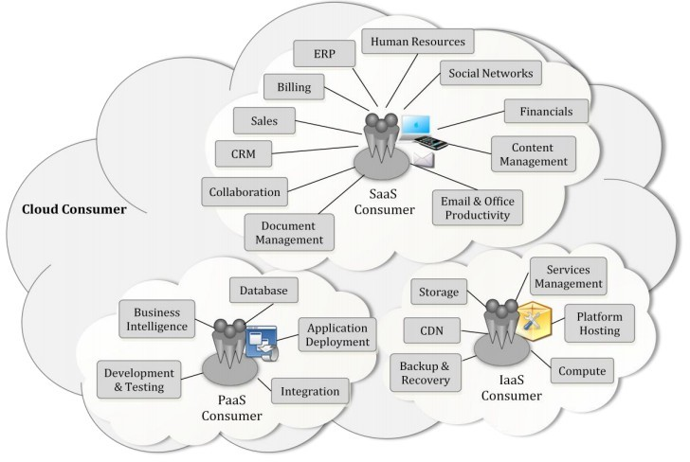
Cloud Consumer
NIST Cloud Computing Reference Architecture

Slide 31
Cloud Provider
Cloud Provider acquires and manages the computing infrastructure required for providing the services, runs the cloud software that provides the services, and makes arrangement to deliver the cloud services to the Cloud Consumers through network access.
SaaS provider deploys, configures, maintains and updates the operation of the software applications on a cloud infrastructure. SaaS provider maintains the expected service levels to cloud consumers.
PaaS Provider manages the computing infrastructure for the platform and components (runtime software execution stack, databases, and other middleware).
IaaS Cloud Provider provides physical hardware and cloud software that makes the provisioning of these infrastructure services, for example, the physical servers, network equipments, storage devices, host OS and hypervisors for virtualization.
NIST Cloud Computing Reference Architecture

Slide 32
Cloud Auditor
Audits are performed to verify conformance to standards.
Auditor evaluates the security controls, privacy impact, performance, etc.
Auditing is especially important for federal agencies.
Security auditing, can make an assessment of the security controls to determine the extent to which the controls are implemented correctly, operating as intended, and producing the desired outcome.This is done by verification of the compliance with regulation and security policy.
Privacy audit helps in Federal agencies comply with applicable privacy laws and regulations governing an individual's privacy, and to ensure confidentiality, integrity, and availability of an individual's personal information at every stage of development and operation.
NIST Cloud Computing Reference Architecture

Slide 33
Cloud Broker
Integration of cloud services can be complex for consumers. Hence cloud broker, is needed.
Broker manages the use, performance and delivery of cloud services and
negotiates relationships between cloud providers and cloud consumers.
In general, a cloud broker can provide services in three categories:
  Service Intermediation: Broker enhances a service by improving capability and providing value-added services to consumers. The improvement can be managing access to cloud services, identity management, performance reporting, enhanced security, etc.
  Service Aggregation: Broker combines and integrates multiple services into one or more new services. The broker provides data integration and ensures the secure data movement.
  Service Arbitrage: It is similar to service aggregation with the flexibility to choose services from multiple agencies. For example, broker can select service with the best response time.
NIST Cloud Computing Reference Architecture

Slide 34
Cloud Carrier
Cloud carriers provide access to consumers through network, telecommunication and other access devices.
For example, cloud consumers can obtain cloud services through network access devices, such as computers, laptops, mobile phones, mobile internet devices (MIDs), etc.
The distribution of cloud services is normally provided by network and telecommunication carriers or a transport agent, where a transport agent refers to a business organization that provides physical transport of storage media such as high-capacity hard drives.
Cloud provider can set up SLAs with a cloud carrier to provide services consistent with the level of SLAs offered to cloud consumers.
NIST Cloud Computing Reference Architecture

Slide 35
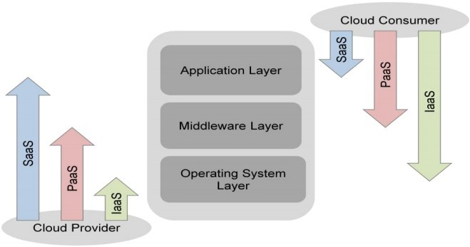
Scope of Control between Provider and Consumer
Application layer are used by SaaS consumers, or installed/managed/ maintained by PaaS consumers, IaaS consumers, and SaaS providers.
Middleware is used by PaaS consumers, installed/managed/maintained by IaaS consumers or PaaS providers. Middleware is hidden from SaaS consumers.
IaaS layer is hidden from SaaS consumers and PaaS consumers.
Consumers have freedom to choose OS to be hosted.
NIST Cloud Computing Reference Architecture

Slide 36


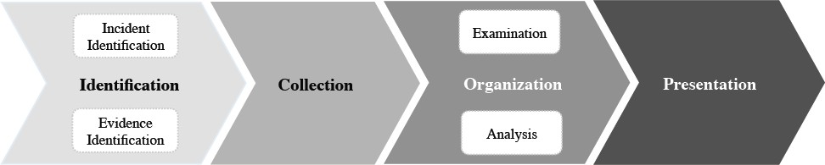





Slide 37


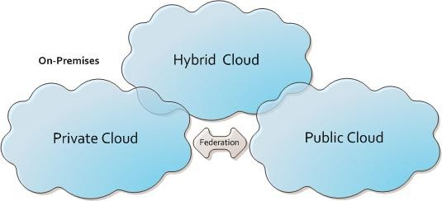
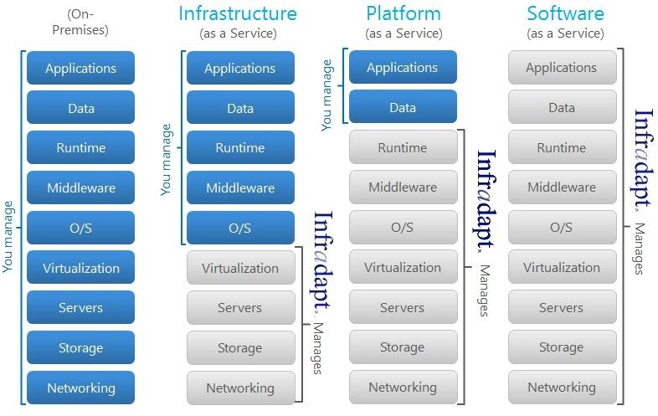

Slide 38



Slide 39
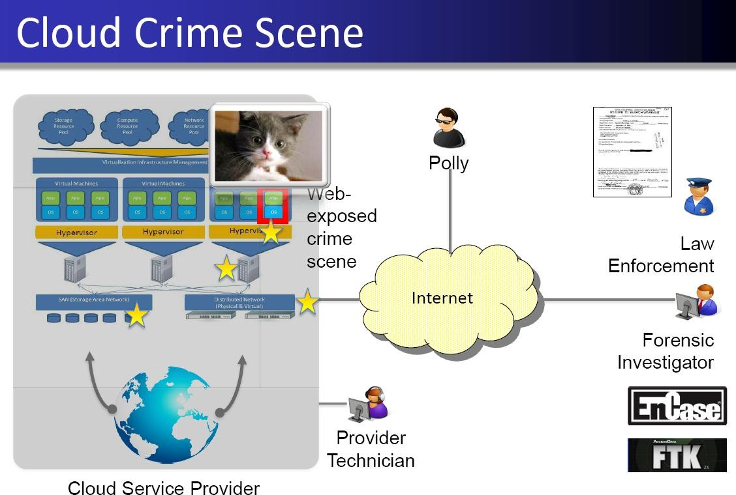

Slide 40

Polly is back again!!!!
Polly is a criminal who traffics in child pornography.
He has set up a service in the cloud to store a large collection of contraband
images and video.
The website allows users to upload and download this content anonymously.
He pays for his cloud services with a pre-paid credit card purchased with cash. Polly encrypts his data in cloud storage, and he reverts his virtual webserver to
a clean state daily.
Law enforcement is tipped off to the website and wishes both to terminate the service and prosecute the criminal.

Slide 41
IaaS assumed
In this service model, the provider has responsibility and access to only the physical hardware, storage, servers and network components.
In the public interest, law enforcement first contacts the cloud provider with a temporary restraining order to suspend the offending service and account, and a preservation letter to preserve evidence pending a warrant.
Tracking down the user is the more difficult task. The onus in this case is on the forensic examiner to piece together a circumstantial case based on the data available.

Slide 42
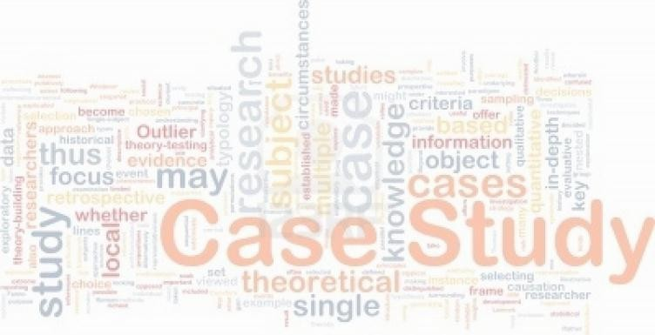

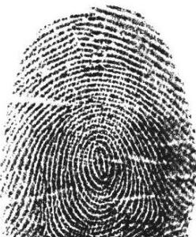
The examiner has no way to image the virtual machine remotely since the cloud provider does not expose that functionality
and in doing so would alter the state of the machine anyway.
Deploying a remote forensic agent, such as EnCase Enterprise, would require the suspect's credentials, and functionality of this remote technique within the cloud is unknown.
-Simply viewing the target website is enough to confirm that the content is illegal, but it tells us nothing about who put it there.

Slide 43
Consider other possible sources of digital evidence in this case:
Credit card payment information
Cloud subscriber information
Cloud provider access logs
Cloud provider NetFlow logs,
Virtual machine
Cloud storage data.
Law enforcement can issue a search warrant to the cloud provider, which is adequate to compel the provider to provide any of this information that they possess. The warrant specifies that the data returned be an “exact duplicate,” ie bit by bit!!!!!(But How?)
A technician at the provider executes the search order from his or her workstation, copying data from the provider's infrastructure and verifying data integrity with hashes of the files.
Though the prosecution may call the technician to testify, we have no implicit guarantees of trust in the technician to collect the complete data, in the cloud infrastructure to produce the true data, nor in the technician's computer or tools used to collect the information correctly. Nonetheless, the provider completes the request, and delivers the data to law enforcement.

Slide 44
Let us say that Polly had two terabytes of stored data.
To transfer that quantity of data, the provider saves it to an external hard drive and delivers it to law enforcement by mail. In addition, the provider is able to produce
Account information
10MB of access logs
100MB of NetFlow records
20GB virtual machine snapshot.
After validating the integrity of the data, the forensic examiner is now charged with Analysis.
We would expect the forensic expert to identify the following that would aid in prosecution:
Understand how the web service works, especially how it encrypts/decrypts data from storage
Find keys to decrypt storage data, and use them to decrypt the data
Confirm the presence of child pornography

Slide 45


This activity may take many man hours to analyze.
AccessData found that their Forensic Toolkit (FTK) product took 5.5 hours to process a 120GB hard drive fully on a top-of-the-line workstationand as long as 38.25 hours on a low-end workstation .
At that rate, 2TB of data could take 85 hours of processing time.
The provider may have returned individual files or large files containing “blobs” of binary data. In either case, it will become quickly evident that the data are encrypted. Tools like EnCase and Forensic Toolkit can analyze VMware data files but not snapshots which include suspended memory.
We were already aware of illegal content, but not aware of the data owner. Timestamps or file metadata may prove useful, provided they are available and accurate. Evidence of the owner may be gleaned from NetFlow, timestamp, and potentially in the coding style of the website. We can safely assume that an IP can be found that points to Polly. All of the forensic analysis is documented and presented to counsel.

Slide 46



Microsoft and Amazon declined to comment about their compliance abilities in this situation

Slide 47

Since raw bit-for-bit copies of hard drives were not provided, how do we know that the
cloud provider provided a complete and authentic forensic copy of the data?
Can the authenticity and integrity of the data be trusted?
Can the cloud technician, his/her workstation and tools be verifiably trusted?
Were the data located on one drive, or distributed over many? Where were the drives containing the data physically located?
-Who had access to the data, and how was access control enforced?
-Were the data co-mingled with other users' data?
If data came from multiple systems, are the timestamps of these systems internally consistent? Can the date and time stamps be trusted, and compared with confidence?

Slide 48




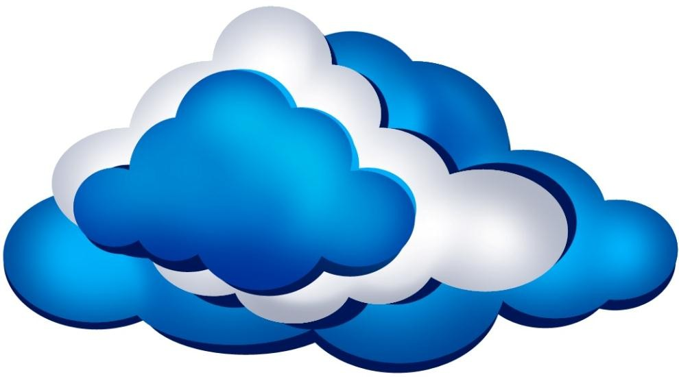

Slide 49
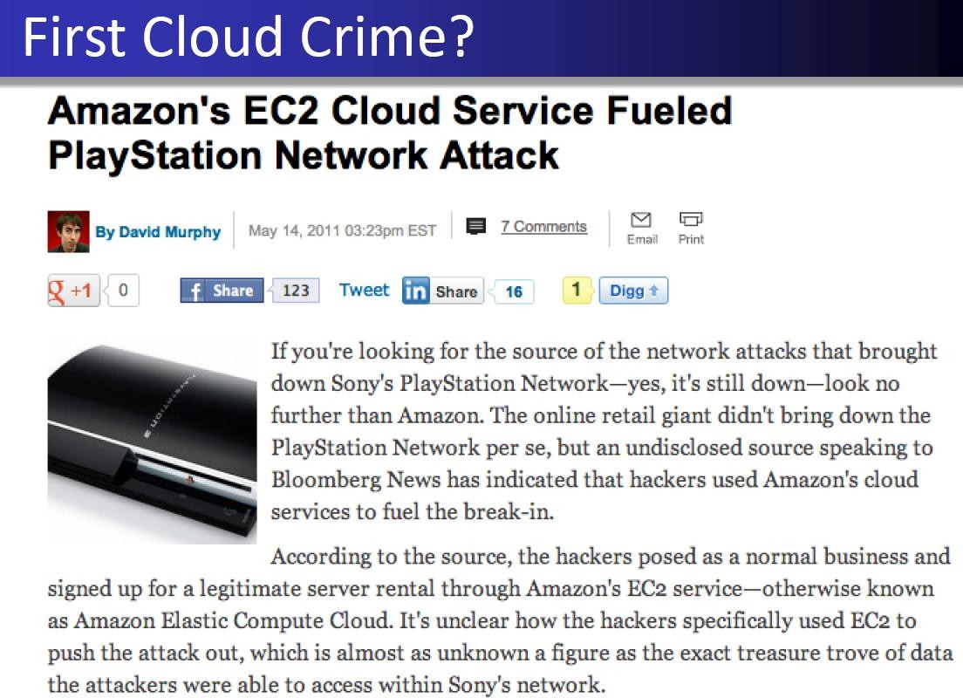

Slide 50



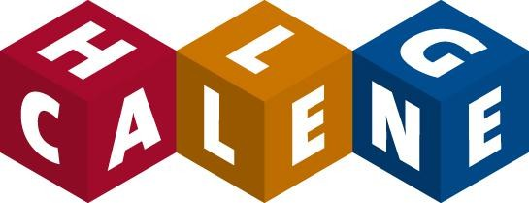
Challenges in Cloud Forensics

Slide 51

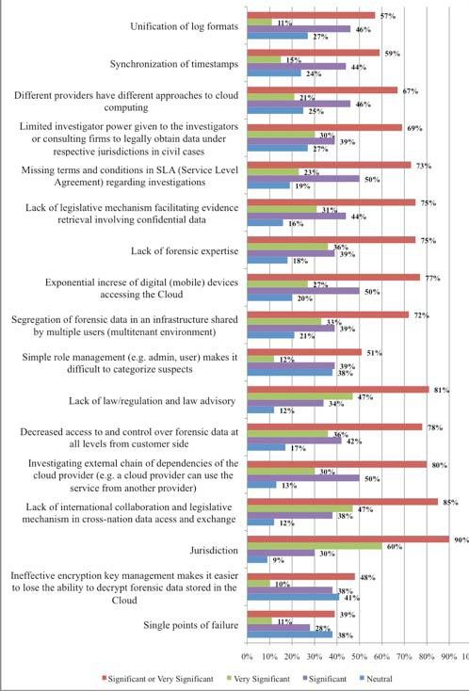
Storage system is no longer local.
Each cloud server contains files from many users.
Even if data belonging to a particular suspect is identified, separating it from other users’ data is difficult.
Other than the CSP, there is usually no evidence that links a given data file to a particular suspect.
Healthcare, business, or national security related data!!!

Slide 52





Slide 53



To investigate this case, the forensics examiner needs a
Case Study of Child Pornography
bit-for-bit duplication of
the
the data
to prove existence of contraband
images and video
But in a cloud, he cannot collect data by himself.

Slide 54
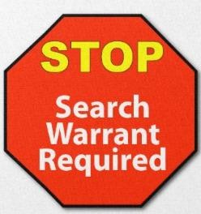


First, he needs to issue a search warrant to the cloud provider.
However, there are some problems with the search warrant in respect of cloud environment.
For example, warrant must specify a location, but in cloud the data may not be located at a precise location or a particular storage server.

Slide 55

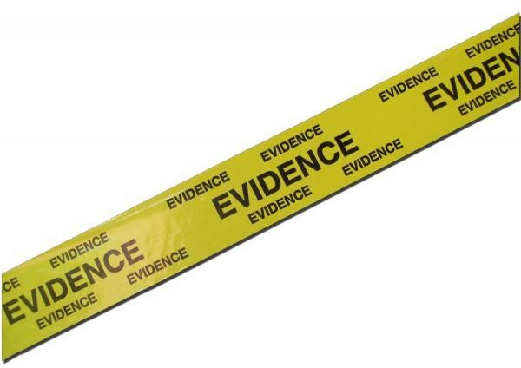
Furthermore, the data can not be seized by confiscating the storage server in a cloud, as the same disk can contain data from many unrelated users.
To identify the criminal, he needs to know whether the virtual machine has a static IP.
Almost in all aspects, it depends on the transparency and cooperation of the cloud provider.

Slide 56

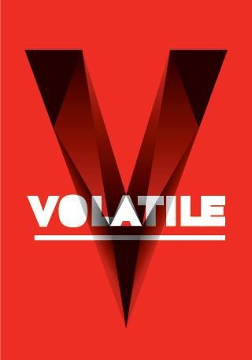


Volatile data cannot sustain without power.
When we turn off a Virtual Machine (VM), all the data will be lost if we do not have the image of the instance….
If we restart or turn off a VM instance in IaaS (e.g., in Amazon EC2), we will lose all the data.
Registry entries or temporary internet files, that reside or be stored within the virtual environment will be lost when the user exits the system.

Slide 57
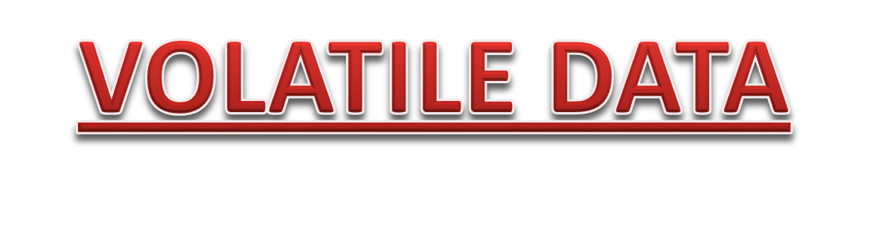
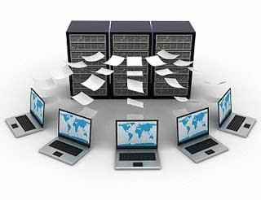
Though with extra payment customers can get persistent storage, this is not common for small or medium scale business organizations.
A malicious user can exploit this vulnerability.
Some owner of a cloud instance can fraudulently claim that her instance was compromised by someone else and had launched a malicious activity. Later, it will be difficult to prove her claim as false by a forensic investigation .
Persistence in computer science refers to the
characteristic of state that outlives
the process that created it. Without this capability, state would only exist in RAM, and would be lost when this RAM loses power, such as a computer shutdown

Slide 58

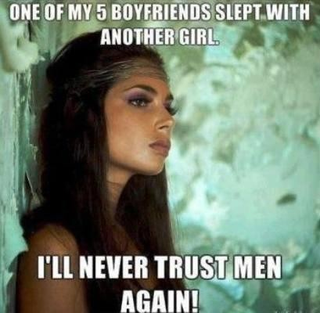
After issuing a search warrant, the examiner needs a technician of the cloud provider to collect data.
However, the employee of the cloud provider who collects data is most likely not a licensed forensics investigator and it is not possible to guarantee his integrity in a court of law .
The date and timestamps of the data are also questionable if it comes from multiple systems.
One of the shortcomings they found is that it is not possible to verify the integrity of
the forensic disk image in Amazon’s EC2 cloud because Amazon does not provide checksums of volumes, as they exist in EC2.

Slide 59


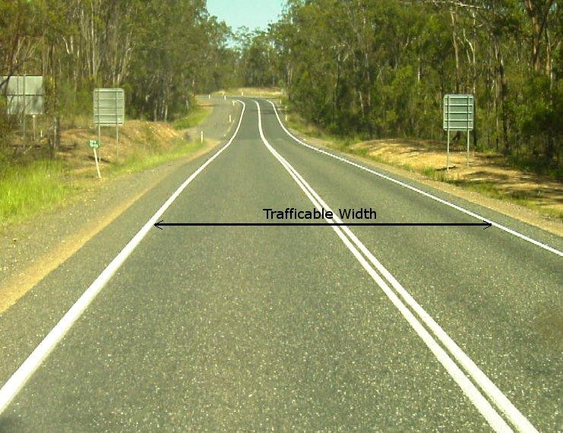
The on-demand characteristic of cloud computing will have vital role in increasing the digital evidence in near future.
In traditional forensic investigation, we collect the evidence from the suspect’s computer hard disk.
Conversely, in Cloud, we do not have
physical access to the data.
One way of getting data from cloud VM is downloading the VM instance’s image.
The size of this image will increase with the increase of data in the VM instance. We will require adequate bandwidth and incur expense to download this large image.

Slide 60



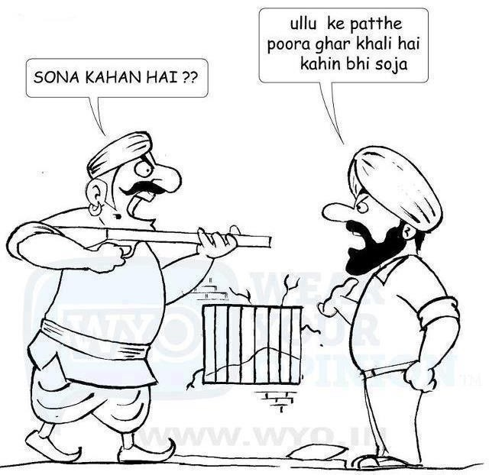


Slide 61
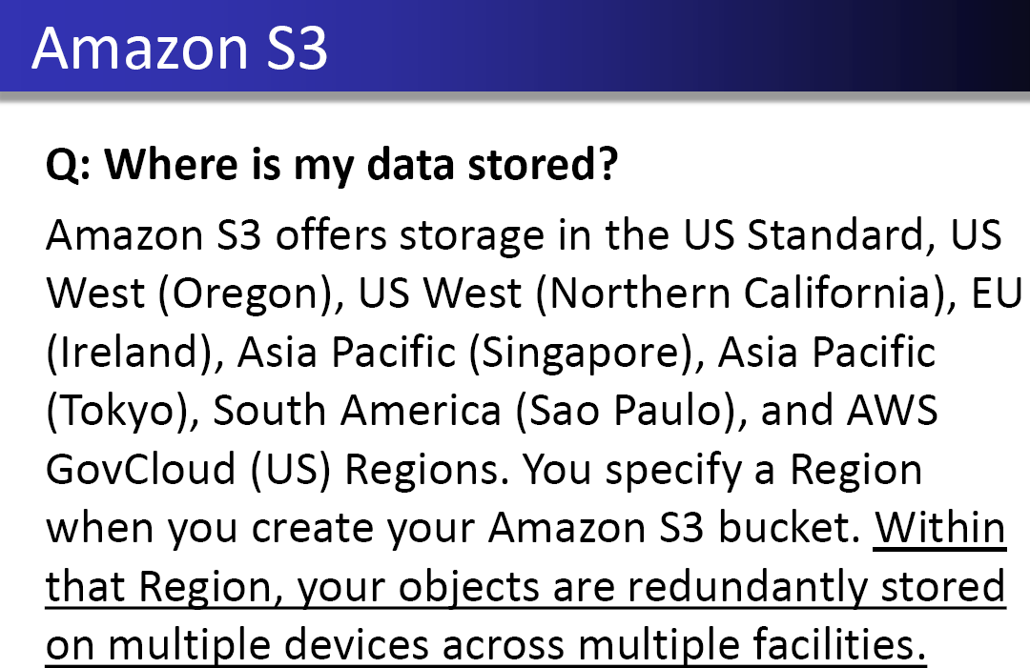

Slide 62
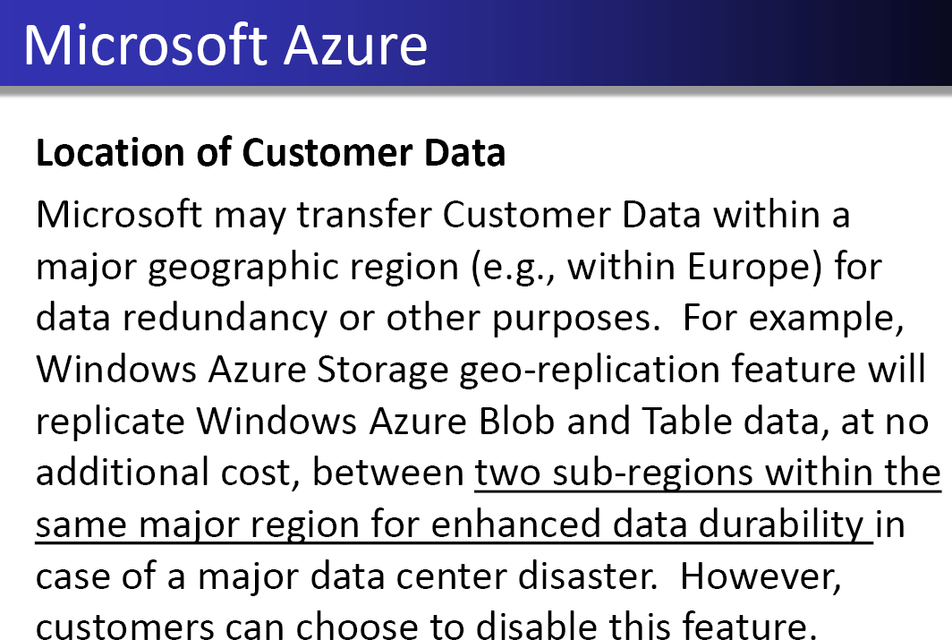

Slide 63



In cloud computing, multiple VM can share the same physical infrastructure, i.e., data for multiple customers may be co-located. This nature of clouds is different from the traditional single owner computer system.
issues can arise.

Slide 64
First, How to prove that data were not comingled with other users’
data ?
Secondly, How to preserve the privacy of other tenants while performing an investigation ?
Both of these issues also brings the Side-Channel Attacks that are difficult to investigate.

Slide 65
SIDE-CHANNEL ATTACKS
“ Using the Amazon EC2 service as a case study, we show that it is possible to map the internal cloud infrastructure, identify where a particular target VM is likely to reside, and then instantiate new VMs until one is placed co-resident with the target. We explore how such placement can then be used to mount cross-VM side-channel attacks to extract information from a target VM on the same machine.”
Source : http://cloudsecurity.org/blog/2009/08/31/cloud-cartography-side-
channel-attacks.html

Slide 66
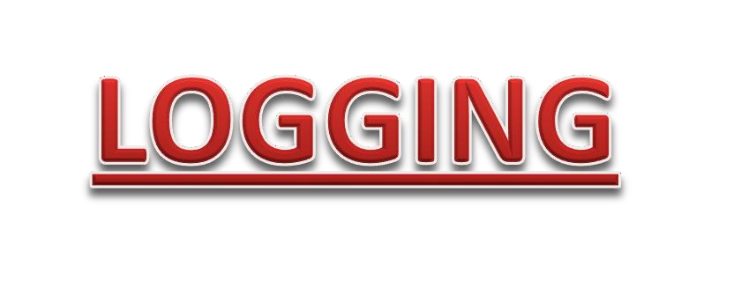

Analyzing logs from different processes plays a vital role in digital forensic investigation. Process logs, network logs, and application logs are really useful to identify a malicious user.
Not as simple as it is in privately owned computer system, Sometimes even impossible.
Challenges :
Decentralization. Volatility of Logs. Multiple Tiers and Layers. Accessibility of Logs.
Dependence on the CSP.
Absence of Critical Information in Logs.

Slide 67
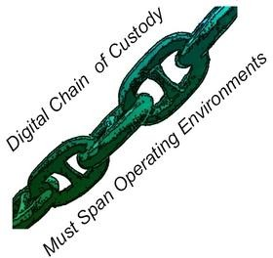
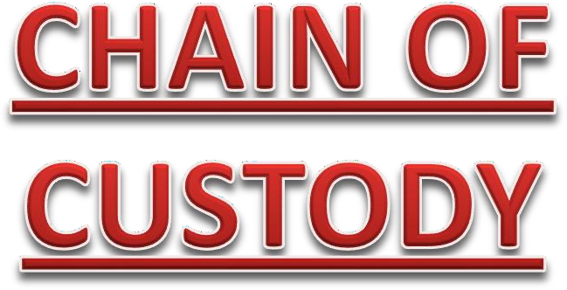



Slide 68



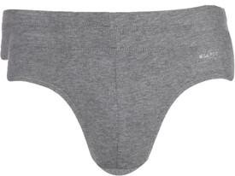

Slide 69
CRIME SCENE RECONSTRUCTION
CROSS BORDER LAW
TRUSTWORTHY DATA RETENTION
For example, who enforces the retention policy in the cloud, and how are exceptions, such as, litigation holds managed? Moreover, how can the CSPs assure us that they do not retain data after destruction of it .There are several laws in different countries, which mandate the trustworthy data retention. Just in United States, there are 10,000 laws
at the federal and state levels that force the organizations to manage records securely. Some of the laws and regulations are stated below:
  Sarbanes-Oxley Act
  The Health Insurance Portability and Accountability Act (HIPAA)
  The Securities and Exchange Commission (SEC) rule
  Federal Information Security Management Act
  The Gramm-Leach-Bliley
  European Commission data protection legislation

Slide 70



Slide 71
Due to the distributed and elastic characteristic of cloud computing, the available forensic tools cannot cope up with this environment.
Tools and procedures are yet to be developed for investigations in virtualized environment, especially on hypervisor level.
Need of FORENSICAWARE tools for the CSP and the clients to collect forensic data.

Slide 72
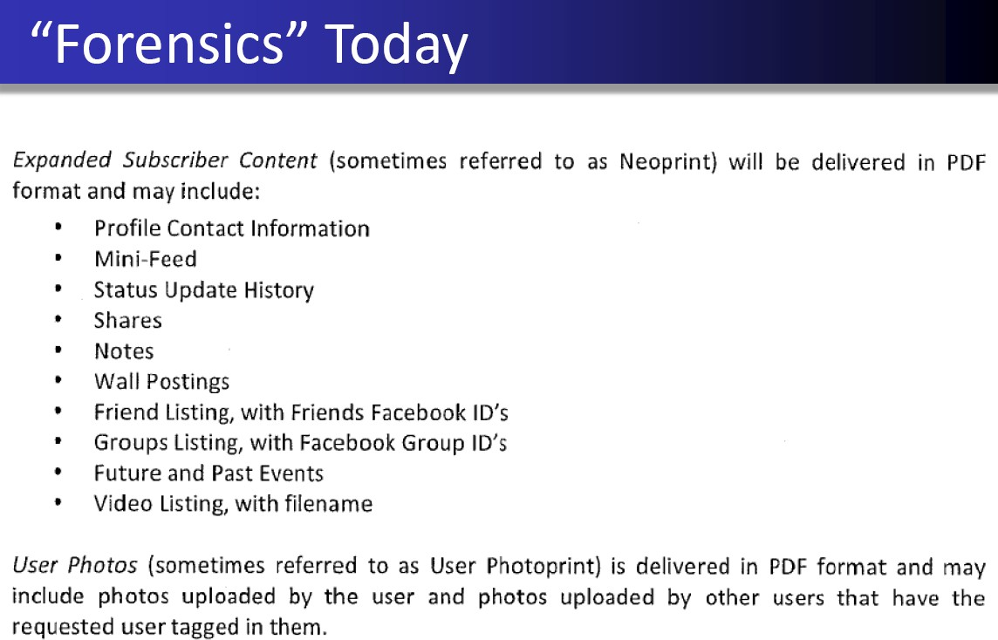

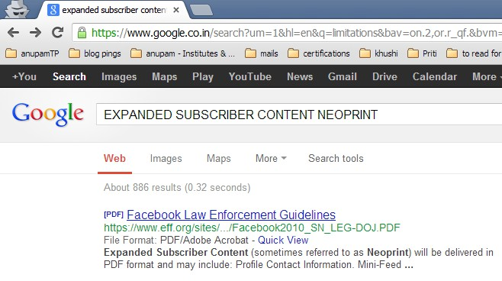

Slide 73



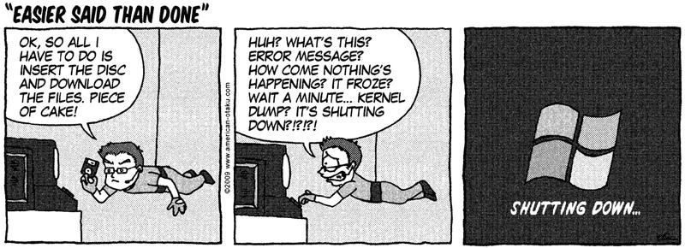

Slide 74

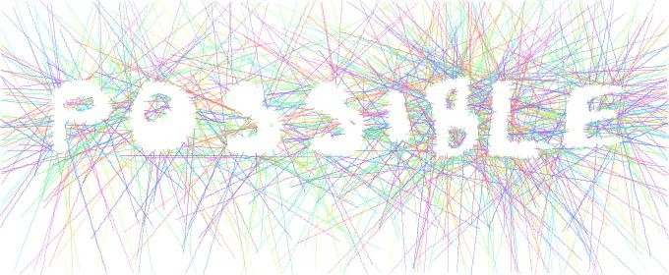
BUILDING A TRUST MODEL
Guest application / data
Guest OS
Proposed a trust model with six layers
Virtualization
Host OS
Physical hardware
Network

Slide 75


INTEGRITY PRESERVATION
Generating a digital signature on the collected evidence and then checking the signature later is one way to validate the integrity. As data is distributed among multiple servers, this procedure is not simple, rather quite complicated.
A distributed SIGNATURE DETECTION FRAMEWORK that will facilitate the forensic investigation in Cloud environment.

Slide 76


DISTRIBUTED SIGNATURE DETECTION FRAMEWORK
Current model of file storage comprises of two components – Meta data Servers (MDS) and Object Storage Devices (OSD). The hash value of each file is stored in the MDS as an e-tag and integrity is checked each time after uploading / downloading a file. In the proposed framework,
First step is to send a list of target buckets to the Forensic Cluster Controller (FCC), along with a file containing the target MD5 hash values. The FCC then initializes and queries to Analysis Nodes (AN) for getting the number of files contained in targeted bucket. Upon receiving the round one signature file from FCC, each AN retrieves the e-tags of the bucket. Second Step, the signatures in the round one signature file are compared with the signatures generated from the etags by the AN. After getting feedback from all ANs, FCC terminates the ANs. They tested their framework by two ways – using Amazon S3 and by emulating a cloud platform. They achieved zero false positive and false negative rate and found significant improvement in terms of data required.

Slide 77


LOGGING
Proposed is a log management solution, which can solve several challenges of logging.
In the first step of the logging solution, logging must be enabled on all infrastructure components to collect logs.
The next step is for establishing a synchronized, reliable, bandwidth efficient, and encrypted transport layer to transfer log from the source to a central log collector.
The final step deals with ensuring the presence of the desired information in the logs.
The proposed guideline tells us to focus on three
things:
When to log, What to log and How to log.

Slide 78


CLOUD MANAGEMENT PLANE
Data acquisition is a challenging step in cloud forensics.
CSPs can play a vital role in this step by providing a web based management console like AWS management console.
From the console panel, customers as well as investigators can collect VM image, network, process, database logs, and other digital evidence, which cannot be collected in other ways.
Only problem with this solution is that, it requires an extra level of trust – trust in the management plane.

Slide 79


SOLUTION OF LEGAL ISSUES
At present, there is a massive gap in the existing Service Level Agreement (SLA), which neither defines the responsibility of CSPs at the time of some malicious incident, nor their role in forensic investigation.
Researches have given emphasis on sound and robust SLA between cloud service providers and customers.
A robust SLA should state how the providers deal with the cyber crimes, i.e., how and to which extent they help in forensic investigation procedure. In this context, another question can come – how we can be sure of the robustness of a SLA.
To overcome the cross border legislation challenges,
It is proposed that an international unity for introducing an international legislation for cloud forensics investigation

Slide 80

VIRTUAL MACHINE INTROSPECTION
Virtual Machine Introspection (VMI) is the process of externally monitoring the runtime state of VM from either the Virtual Machine Monitor (VMM), or from some virtual machine other than the one being examined.
By runtime state, we are referring to processor registers, memory, disk, network, and other hardware-level events.
Through this process, we can execute a live forensic analysis of the system, while keeping the target system unchanged.

Slide 81

CONTINUOUS SYNCHRONIZATION
To overcome the problem of volatile data, explore possibility of continuous synchronization of the volatile data with a persistent storage
Two possible ways of continuous synchronization.
CSPs can provide a continuous synchronization API to customers. Using this API, customers can preserve the synchronized data to any cloud storage e.g., Amazon S3, or to their local storage.
However, if the adversary is the owner of a VM!!!!then what?

Slide 82

TRUSTED PLATFORM MODULE (TPM)
By using TPM, we can get machine authentication, hardware encryption, signing, secure key storage, and attestation.
It can provide the integrity of the running virtual instance, trusted log files, and trusted deletion of data to customers.
Moreover, at present, CSPs have heterogeneous hardware and few of them have TPM. Hence, CSPs cannot ensure a homogeneous hardware environment with TPM in near future.

Slide 83


ISOLATING A CLOUD INSTANCE
A cloud instance must be isolated if any incident take place on that instance.
Isolation is necessary because it helps to protect evidence from contamination. However, as multiple instances can be located in one node, this task becomes challenging.
Moving a suspicious instance from one node to another node may result in possible loss of evidence.
To protect evidence, we can move other instances reside in the same node.

Slide 84
Provenance in Clouds
Cloud provenance can be
  Data provenance: Who created, modified, deleted data stored in a cloud (external entities change data)
  Process provenance: What happened to data once it was inside the cloud (internal entities change data)
Cloud provenance should give a record of who accessed the data at different times
Auditors should be able to trace an entry (and associated modification) back to the creator

Slide 85

Cybercrime and Cloud Forensics: Applications for Investigation Processes, IGI
Global, 2013 (edited book)
Cloud Forensic Reference Architecture (CFRA) Cloud Forensic Maturity Model (CFMM)
UCD CCI: Cloud Forensic Capability and Requirement Study for EU Law Enforcement NIST Cloud Computing Forensic Science Working Group
CSA Cloud Forensics and Incident Management Working Group

Slide 86

CAN YOU PREPARE FOR CLOUD FORENSICS?
The key to avoiding much of this pain is being prepared before an incident occurs.
Once you become a customer, you have lost much of your leverage……..

Slide 87
Some of the things you should consider negotiating:
The provider will notify you immediately if there is any type of breach on the provider’s system since it may impact your data.
The provider will allow you to access to the servers or system so you can self-collect.
Determine what type of data the provider collects, how long the provider holds it, and if the provider will store this data for you for a longer period of time.
Determine if the provider actually owns and controls the servers.
Write a business continuity/disaster recovery plan.
Determine where—in what state, states, or country—your data will be stored so you can determine which laws may apply.

Slide 88

EVALUATION OF CURRENT FORENSIC TOOLS IN CLOUD
Proven digital forensics tools used by forensic investigators :
Encase
Accessdata FTK
Fast Dump from HBGary Memorysze from Mandiant

Slide 89
EVALUATION OF CURRENT FORENSIC TOOLS IN CLOUD
Three experiments and data collected from three different layers and got success in all the experiments.
In the first experiment, they collected forensic data remotely from the guest OS layer of cloud. Encase Servlets and FTK Agents are the remote programs, which were used to communicate and collect data.
For the second experiment, they prepared an Eucalyptus cloud platform and collected data from the virtualization layer.
In the third experiment, they tested the acquisition at the host operating system
layer by Amazon’s export feature.
Source : Acquiring Forensic Evidence from Infrastructure-as-a-Service Cloud Computing: Exploring and Evaluating Tools, Trust, and Techniques

Slide 90


EXTRACTING DATA FROM AMAZON EC2

Slide 91



Slide 92


Cloud computing can reduce the time for data acquisition, data copying, transferring and
data cryptanalysis.
Forensic image verification time reduced if cloud application generates cryptographic hash.
Cost effectiveness
Data abundance
Overall robustness
Scalability
Flexibility
Standards and Policies
Forensics-as-a Service - Customers do not need to implement any forensic schemes.

Slide 93




Slide 94







Slide 95


